Slide 1

2027 Capital Planning Meeting
Comprehensive Infrastructure & Departmental Capital Project Review
SEPTEMBER 22, 2026

Slide 2

Budget Workshop Agenda
01 Call to Order
02 Pledge of Allegiance
03 Motion to Consider Consent Agenda
Governance Objective
04 Capital Budget Discussion
The purpose of this capital planning workshop is to evaluate ongoing municipal projects, review departmental priority requests for fiscal year 2027, and establish long-term funding pathways for major infrastructure, safety, and equipment needs across New Britain Township.
05 Public Comment
06 Announcements
07 Adjournment
TOWNSHIP OF NEW BRITAIN
2027 CAPITAL PLANNING PRESENTATION

Slide 3

SECTION I • STATUS REVIEW
Status of 2026 Capital Projects
A comprehensive review of budgeted capital projects for New Britain Township during the 2026 fiscal year.
TOWNSHIP OF NEW BRITAIN
2026 PROJECT STATUS

Slide 4


2026 Budgeted Capital Projects
Administration
Parks & Recreation
■
Digital Upgrades: Digitizing township files ($60K), Interactive Zoning Map ($11K)
■
Park Infrastructure Upgrades: North Branch Park Tot Lot Replacement & Pavilion ($478K), Highlands Park 4 Basketball Half Courts ($35K), Pine Run Trail Planning ($50K)
■
Building Upgrades: Digital Signage Board for Township Building ($40K), Consulting Fees ($50K)
■
Equipment: EXMARK 96-inch Diesel Mower ($45K), TX 525 Dingo Wide Track Machine ($48K)
■
MS4 Projects: Crescent Dr/Waldon Way Basin Retrofit & Stream Realignment ($100K)
Police Department
Public Works
■
Equipment Replacement: Two (2) Wheel Load Weigher Scales ($15K)
■
Road Improvements: Additional In-House Paving Funds ($300K)
■
Vehicles: Patrol vehicle with upfitting ($95K), Chief administrative vehicle ($80K), Detective administrative vehicle ($80K)
■
Equipment & Facilities: Dump Truck Replacement of Mack 2010 ($300K)
TOWNSHIP OF NEW BRITAIN
BUDGETED PROJECTS REVIEW
Notes:
Digitizing township files – did round 1, 60K complete
Interactive zoning map – bad contract language, spent nothing, can do in Traisr for free
Digital signage board – will be completed in early 2027, slightly over budget but made up with other canceled projects
Consulting fees – wrapped up in planning and design element, no fees incurred
MS-4 – 62K so far and wrapping up, probably won’t hit 100K
NB – tot lot is done, pavilion is coming soon, about 100k under budget (check w/ bill)
Basketball Park – pushed to 2027 because team does not have time
Pine Run Trail Planning – pushed to 2027 per Craig
Diesel Mower – Received
Dingo – Received
Wheel Load Weigher Scales – Received
3 Vehicles – Received
In-House Paving – Occurring Now, might not use the full 300K due to manpower
Dump Truck – Only paid for classy, just waiting on body and upfit which should be completed by EOY

Slide 5
SECTION II • FISCAL YEAR 2027
5 Year Capital Improvement Plan
Detailed breakdown of proposed capital expenditures for 2027, as well as tentative requests for 2028 through 2031. Additional context is provided on Schedule C: Capital Expenses.
TOWNSHIP OF NEW BRITAIN
2027 PROPOSED CAPITAL REQUESTS

Slide 6

2027 Administrative Requests
5-Year Capital Improvement Schedule
$30,000
Board Room Technology Upgrades
Upgrades to improve current limitations for presentations
Project / Item Description | 2027 Capital | 2028 Capital | 2029 Capital | 2030 Capital | 2031 Capital
Board Room Tech Upgrades | $30,000 | - | - | - | -
Comprehensive Plan Update | - | $75,000 | - | - | -
Digitizing Files | $60,000 | $40,000 | $40,000 | $40,000 | $40,000
Exterior Safety Upgrades | $100,000 | - | - | - | -
Interior Safety Upgrades | $150,000 | - | - | $350,000 | -
MS-4 Stormwater Projects | $260,000 | $415,000 | $210,000 | - | -
Software Enhancements | $11,000 | $100,000 | - | - | -
Total Admin Requests | $611,000 | $630,000 | $250,000 | $390,000 | $40,000
$60,000
Digitizing Files
SCANTEK to digitize the remainder of Township parcel files
$100,000
Exterior Safety Upgrades
Concrete repairs of walkway and steps
Interior Safety Upgrades
$150,000
Township building lobby upgrades including ADA compliant restrooms, new floor, new windows
MS-4 Project
$260,000
Crescent Drive/Walden Way phase 1 basin retrofit
Software Enhancements
$11,000
Primepoint HR Module, Laserfiche file storage, Traisr online permit portal & citizen reporter
TOWNSHIP OF NEW BRITAIN
ADMINISTRATIVE REQUESTS

Slide 7
2027 Police Requests
$42,000
5-Year Capital Improvement Schedule
ATV Vehicle
Used for special events and patrolling trails
Project / Item Description | 2027 Capital | 2028 Capital | 2029 Capital | 2030 Capital | 2031 Capital
ATV Vehicle | $42,000 | - | - | - | -
Facility Upgrades | $750,000 | $12,500,000 | - | - | -
Mobile Message Board | $30,000 | - | - | - | -
Vehicles & Upfits | $175,000 | $175,000 | $175,000 | - | $87,500
Portable Radios | - | $42,000 | $42,000 | - | -
Public Safety Improvements | $10,000 | $75,000 | - | - | -
Tasers | $30,000 | - | - | - | -
Total Police Requests | $1,037,000 | $12,792,000 | $217,000 | - | $87,500
$750,000
Facility Upgrades
Current facility is outdated and not functional. Engineer and architect costs
$30,000
Mobile Message Board
Increase general messaging & traffic enforcement throughout the township
Police Vehicles
$175,000
Vehicle replacements (with upfitting costs) for 48-02 and 48-15
Public Safety – School Zone Improvements
$10,000
Improve safety concerns at St. Jude school (engineering only)
Tasers
$30,000
Beyond life cycle
TOWNSHIP OF NEW BRITAIN
POLICE REQUESTS

Slide 8
2027 Parks & Rec Requests
$15,000
5-Year Capital Improvement Schedule
Trail Sealing for Walking Trails
Equipment rental to reduce repaving costs and increase trail longevity
Project / Item Description | 2027 Capital | 2028 Capital | 2029 Capital | 2030 Capital | 2031 Capital
Coleman Property: House Demolition | - | - | - | $50,000 | -
Cotton Park Design | - | - | $100,000 | - | $5,000,000
Trail Sealing for Walking Trails | $15,000 | - | - | - | -
North Branch Park Updates | $145,000 | $300,000 | - | - | -
Highlands Park Updates | $80,000 | $150,000 | - | - | -
Veterans Park Updates | - | - | $80,000 | $80,000 | -
Pine Run Trail & Bridge | $25,000 | $400,000 | - | - | -
Total Parks Requests | $265,000 | $850,000 | $180,000 | $130,000 | $5,000,000
$20,000
Concession Stand Updates
North Branch Park: Concession stand upgrades including new roof and paint
$125,000
Rear Parking Lot Paving
North Branch Park: Parking lot paving per a long-time community request
Basketball Half-Courts
$35,000
Highlands Park: Four courts (project delayed from 2026)
Walking Trail Reconstruction
$45,000
Highlands Park: Rebuild walking trail in-house
Pine Run Trail & Bridge
$25,000
Engineering costs for construction to take place in 2028
TOWNSHIP OF NEW BRITAIN
PARKS & RECREATION REQUESTS

Slide 9
2027 Public Works Requests
5-Year Capital Improvement Schedule
$30,000
Building: Salt Storage
Replaces deteriorating salt storage building and doubles the size (engineering only)
Project / Item Description | 2027 Capital | 2028 Capital | 2029 Capital | 2030 Capital | 2031 Capital
Buildings Replacements Pole Barn / Morton Building, Salt Storage Building | $30,000 | $210,000 | $300,000 | - | -
Equipment Crack Sealer, Mini Excavator, Roller, Salt Boxes, Trailer | $30,000 | $75,000 | $75,000 | $25,000 | $100,000
Keller Road Bridge Repairs | - | $200,000 | - | - | -
Mechanic Diagnostic Tool | $10,000 | - | - | - | -
Pedestrian Improvements to Traffic Signals | - | - | $250,000 | - | -
PW Garage Upgrades | $27,000 | - | - | - | -
Vehicles Dump Truck, Pickup Truck | $160,000 | - | $100,000 | $300,000 | $100,000
Total Parks Requests | $257,000 | $485,000 | $725,000 | $325,000 | $200,000
$30,000
Equipment: Salt Boxes
Use with pick-ups to speed up salting and plowing operations
$10,000
Mechanic Diagnostic Tool
Plug-in tool for mechanic to diagnose equipment issues (currently outsourced)
PW Garage Upgrades
$27,000
Fixes HVAC issues with introduction of 2 heat pumps and 3 indoor units
Vehicle: Little Dump Truck (F-550)
$160,000
New addition to fleet; More universal truck
TOWNSHIP OF NEW BRITAIN
PUBLIC WORKS REQUESTS

Slide 10


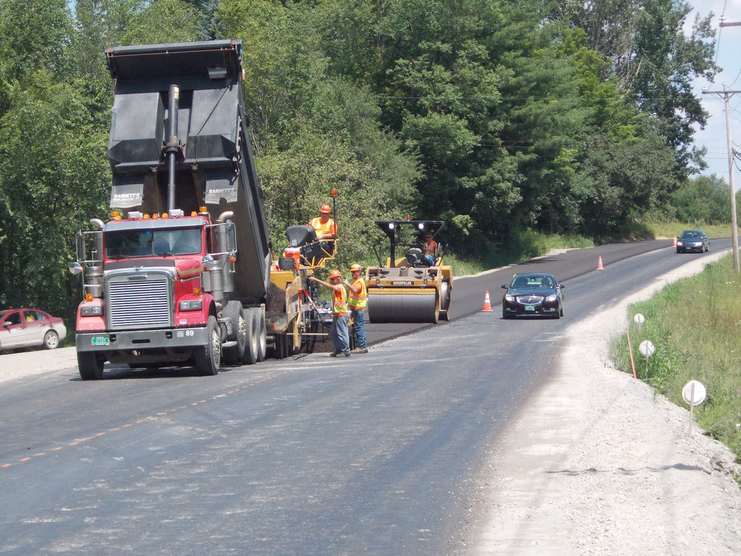
Road Program Schedule
TENTATIVE Paving & ADA Ramps
■
Annual Funding: Liquid Fuels ($550,000) + Capital ($300,000)
■
Timing: This schedule is TENTATIVE and subject to change
■
2027: Blyden Square: E Cornwall Dr, North Ln, Taft Dr, Bates Dr
Independence Ln, Liberty Ln
New Britain Blvd
■
2028: Pheasant Run: Pheasant Run Dr, Pueblo Rd, Mohegan St, Cayuga Ct, Oneida Ln, Seneca Dr, Lenape Dr
Schoolhouse Rd (Partial)
Wyndham: Willow Wood Dr
■
2029: Blue Jay Rd
Silversmythe: E Fairwood Dr, Barberry Ct, Aspen Ct, Harrison Forge Ct
Upper State Rd (Partial)
■
2030: Circle Dr, Brit Way
Holly Dr, Hardwood Ct, White Tail Ct, Sugar Bush Ct
Schoolhouse Rd (Partial)
Upper State Rd (Partial)
■
2031: Brookdale Dr
Overlook: Overlook Dr, Stonyhill Dr, Stream Ct, Ridge Ct, Homestead Ct
Sunnybrook Dr
Twin Maples: Crescent Dr
This Photo by Unknown Author is licensed under CC BY-NC-ND
TOWNSHIP OF NEW BRITAIN
ROAD PROGRAM SCHEDULE

Slide 11
SECTION III • FINANCIAL ANALYSIS
Capital Plan Costs & Funding
Comprehensive cost breakdown and proposed fund allocation for all New Britain Township capital projects.
TOWNSHIP OF NEW BRITAIN
PLAN COSTS & FUNDING

Slide 12



2027 Capital Expenditures Summary
$3.02M
$0.98M
$2.05M
TOTAL PROPOSED PROJECTS
DUE FROM OTHER FUNDS
DUE FROM CAPITAL FUND
Department / Functional Area | Total Project Cost $ | Total Project Cost % | Due from Other Funds | Capital Projects Fund
Administrative | $101,000 | 3.3% | - | $101,000
Buildings & Grounds | $250,000 | 8.3% | - | $250,000
Police Services | $1,037,000 | 34.3% | - | $1,037,000
Storm Sewers & Drains | $260,000 | 8.6% | - | $260,000
Public Works | $257,000 | 8.5% | $160,000 | $97,000
Highway Construction | $850,000 | 28.2% | $550,000 | $300,000
Parks | $265,000 | 8.8% | $265,000 | -
Total Capital Expenditures | $3,020,000 | 100.0% | $975,000 | $2,045,000
TOWNSHIP OF NEW BRITAIN
EXPENDITURE SUMMARY

Slide 13
SECTION IV • FEEDBACK
Project Prioritization
Department heads will be asked to provide feedback on how they would prioritize their projects.
TOWNSHIP OF NEW BRITAIN
PROJECT PRIORITIZATION

Slide 14

2027 Budget Updates
Summary of Budget Changes
■
New Fund: Fire [Fund 03] and EMS [Fund 05] split into separate funds
■
Supporting Details: Detailed breakdowns added for real estate tax revenue, insurance, capital costs, employee benefits, debt service, and salaries
■
Historical Data: 2024 and 2025 actuals added for year-over-year comparison
■
Consolidated RE Tax: Prior year, interim, and delinquent lines merged into a single “Prior Years” line
■
Department Restructure: Departments realigned to DCED standards, such as Governing Body, Executive, General Administration, and IT
■
Standardized Naming: Account names and GL codes updated to be consistent with DCED conventions across all departments
■
Building & Zoning: Planning, Zoning, Building and Code Enforcement consolidated into one department
■
Consolidated Accounts: Redundant line items combined within departments to improve readability
■
Township-Wide Costs: Shared costs such as insurance centralized at the Township level rather than split across departments
TOWNSHIP OF NEW BRITAIN
BUDGET CHANGES

Slide 15
SECTION V • NEXT STEPS
Budget Calendar
Outlining the road ahead for the 2027 budget process.
TOWNSHIP OF NEW BRITAIN
BUDGET CALENDAR

Slide 16


Questions & Discussion
Thank you to the Board of Supervisors,
Department Heads, and Community Members.
New Britain Township Administration

